Slide 1
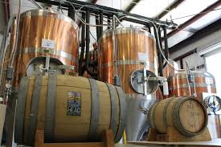

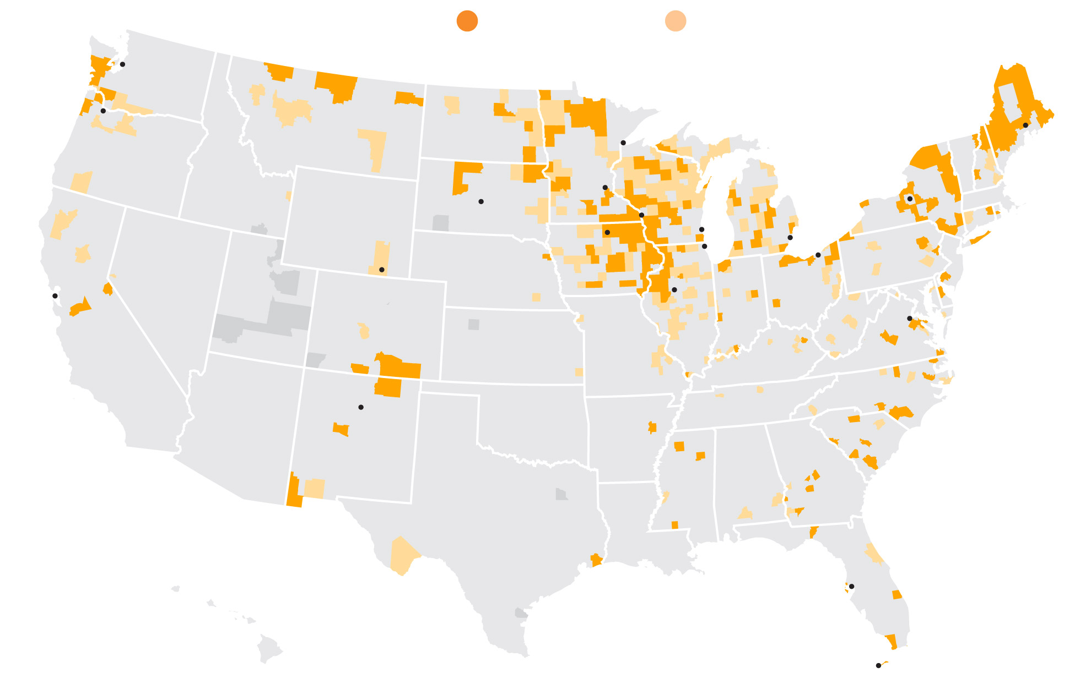
Anheuser – Busch Breweries
BALDWINSVILLE, NY
CARTERSVILLE, GA
COLUMBUS., OH
LOS ANGELES, CA
NEWARK, NJ
WILLIAMSBURG, VA
FAIRFIELD, CA
FORT COLLINS, CO
HOUSTON, TX
JACKSONVILLE, FL
MERRIMACK, NH
ST. LOUIS, MO

Slide 2

$ Beer Sales
Dallas, TX $8 Million Per Month
Chicago, IL $7 Million Per Month
Kansas City, KS $5.8 Million Per Month
Seattle, WA $5 Million Per Month
Houston, TX $4 Million Per Month

Slide 3
Higher ABV Brewers Concentration
Dallas, TX 34 Breweries
Houston, TX 25 Breweries
Chicago, IL 24 Breweries
Kansas City, KS 14 Breweries
Seattle, WA 13 Breweries

Slide 4
Profit Margin?
Top Brewery
Top Brewery
Top Brewery
Top Brewery
Top Brewery

Slide 5
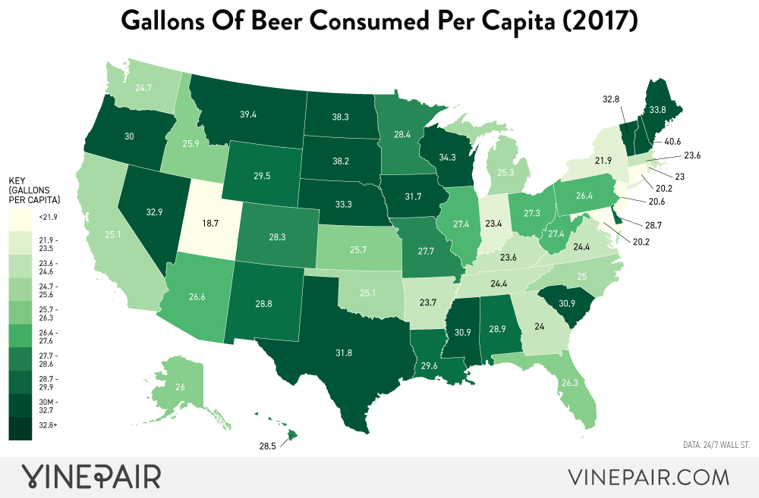
Profit Margin?
Top Brewery
Top Brewery
Top Brewery
Top Brewery
Top Brewery

